Slide 1
Crime Analysis

Slide 2
Table of contents
01
02
03
04
05
06
Introduction
Purpose
EDA
Data Cleaning
GroupBy, Crosstab
Visualization

Slide 3
01
Introduction

Slide 4
Dataset Overview
The dataset comprises detailed information on various crime incidents reported within the city of Chicago from 2012 to 2017. Each record in the dataset represents a specific crime incident and includes attributes such as the unique identifier (ID) and case number assigned by the Chicago Police Department, the date and location of the incident, the type and description of the crime, arrest details, and geographic identifiers such as beat, district, ward, and community area.

Slide 5
Attributes
ID: Unique identifier for each crime record.•
Case Number: Unique identifier assigned by the Chicago Police Department for each incident.•
Date: Date when the incident occurred, sometimes estimated.•
Block: Partially redacted address where the incident occurred, indicating the same block as the actual address.
IUCR: Illinois Uniform Crime Reporting code linked to the Primary Type and Description
Primary Type: Primary description of the crime.•
Description: Secondary description of the crimes, providing further details.•
Location Description: Description of where the incident occurred.
Arrest: Indicates whether an arrest was made in connection with the incident.•

Slide 6
Attributes
Domestic: Indicates if the incident was domestic-related according to Illinois Domestic Violence Act.•
Beat: Indicates the smallest police geographic area where the incident occurred.•
District: Indicates the police district where the incident occurred.•
Ward: City Council district where the incident occurred.•
Community Area: Indicates the community area where the incident occurred.•
FBI Code: Federal Bureau of Investigation code, is a system used to classify different types of crimes based on their characteristics

Slide 7
Attributes
X Coordinate: X-coordinate of the incident location in State Plane Illinois East NAD 1983 projection.•
Y Coordinate: Y-coordinate of the incident location in State Plane Illinois East NAD 1983 projection.•
Year: Year when the incident occurred.•
Updated On: Date and time when the record was last updated.•
Latitude: Latitude of the incident location.•
Longitude: Longitude of the incident location.•
Location: Location of the incident in a format suitable for geographic operations and mapping.

Slide 8
02
Purpose

Slide 9

Purpose
Analyzing the Chicago Crime Dataset (2012-2017) helps us understand how crime changes over time and where it happens most often in the city. By looking at when and where crimes occur, we can figure out which areas need more attention from the police. We can also see how well the police are doing in catching criminals, especially in cases of domestic violence. This information helps city leaders make smarter decisions about how to keep people safe and reduce crime in Chicago.

Slide 10
03
Exploratory Data Analysis

Slide 11
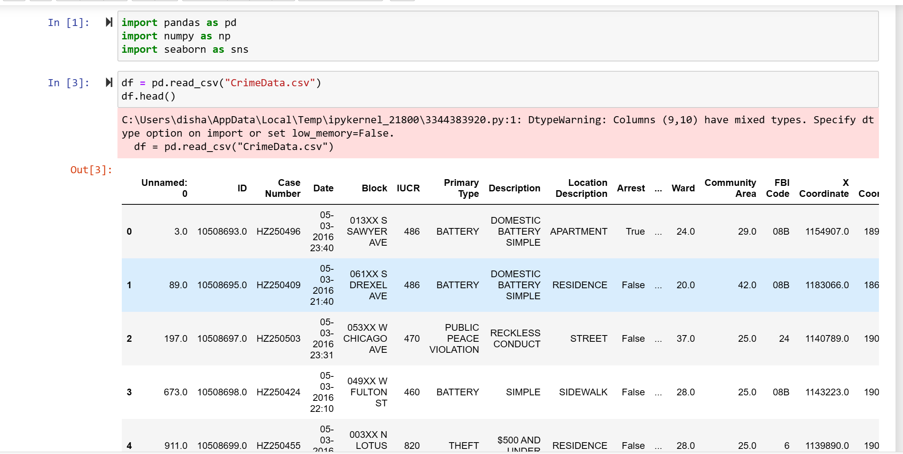
Exploratory Data Analysis
Import the data
Displaying initial data

Slide 12
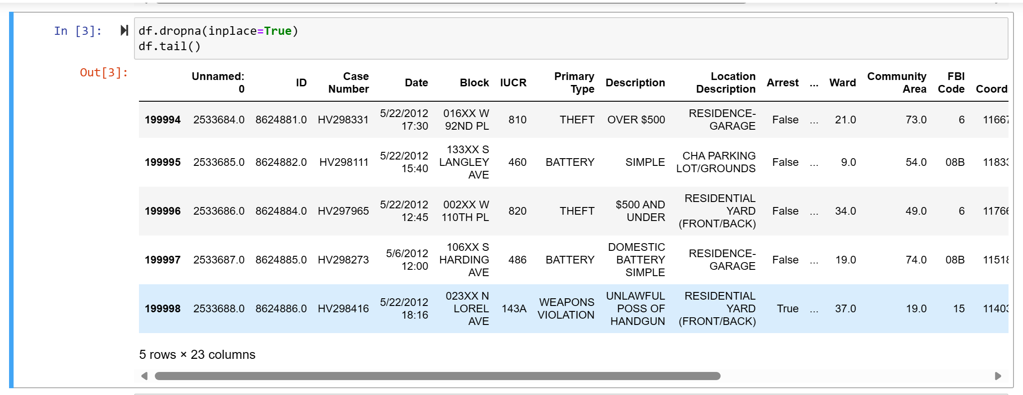
Exploratory Data Analysis
3. Displaying last data

Slide 13
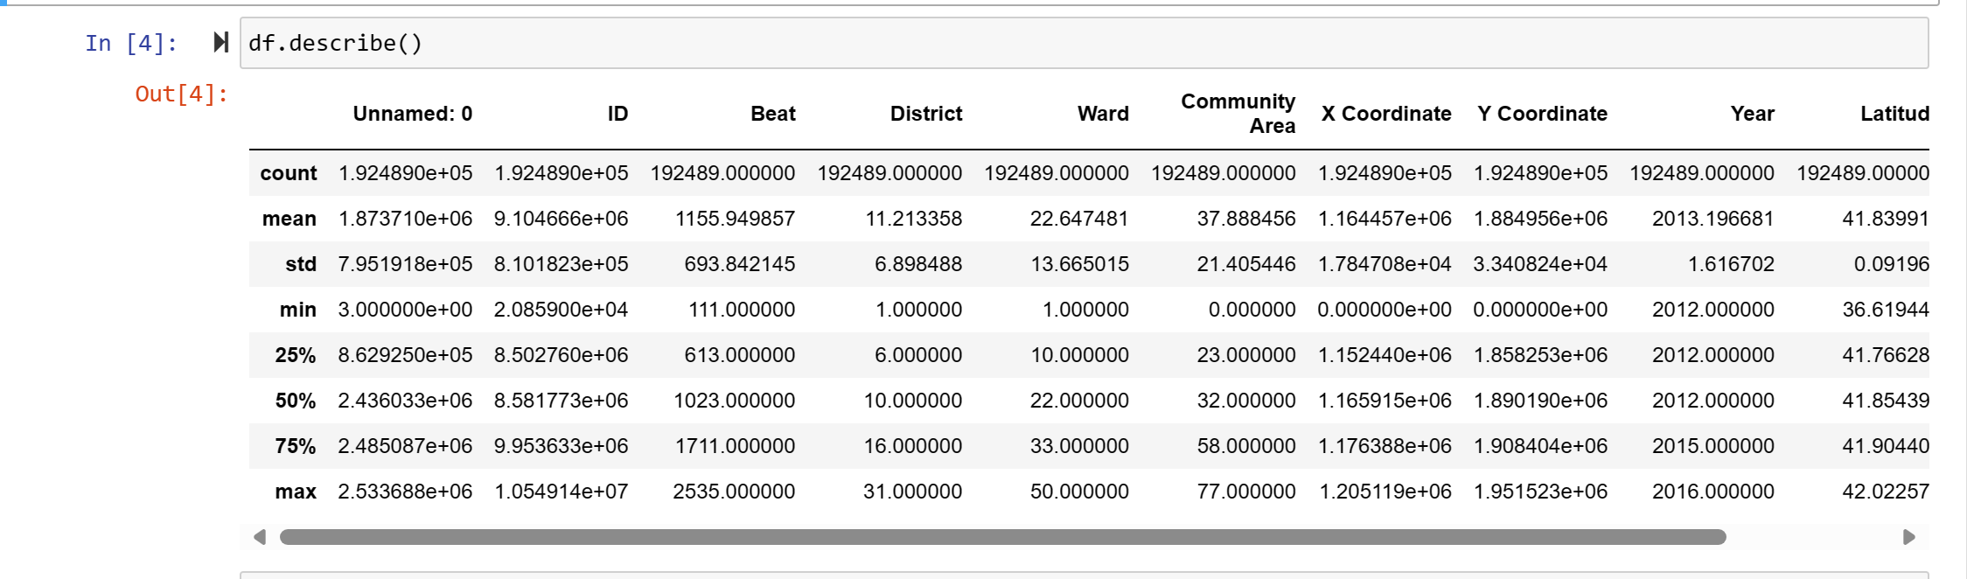
Exploratory Data Analysis
4. Statistical summary of numerical columns

Slide 14
Exploratory Data Analysis
5. Displaying total number of rows and columns

Slide 15
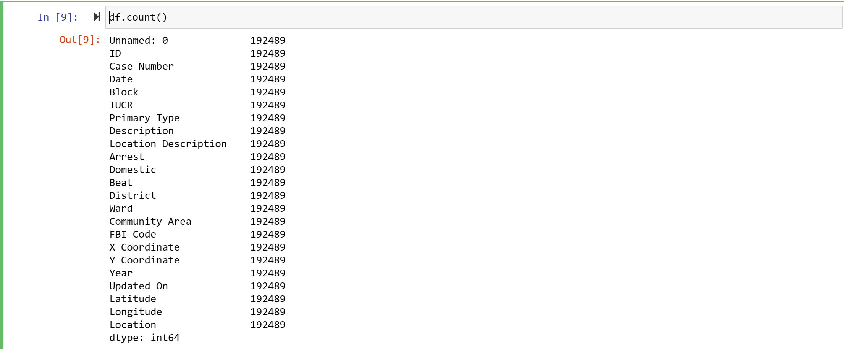
Exploratory Data Analysis
6. Displaying total number of rows in each column

Slide 16
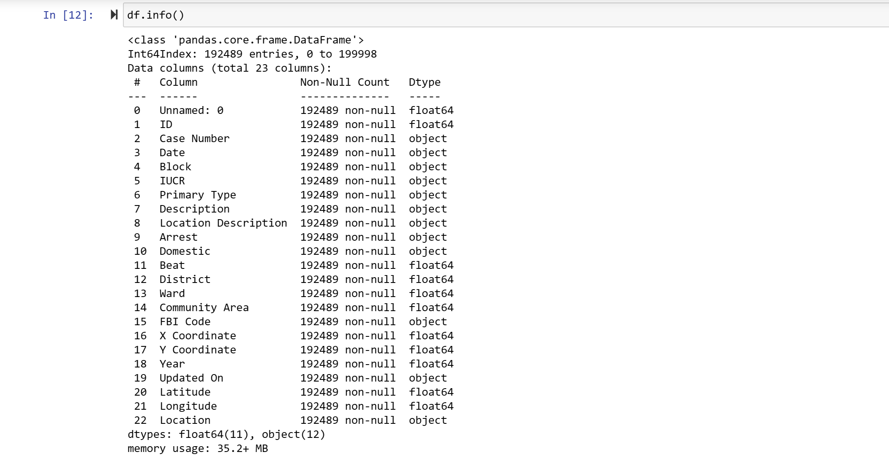
Exploratory Data Analysis
7. Displaying Data types of each column and the number of non-null values

Slide 17
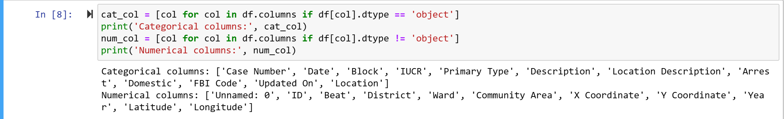
Exploratory Data Analysis
8. Displaying categorical and numerical columns

Slide 18
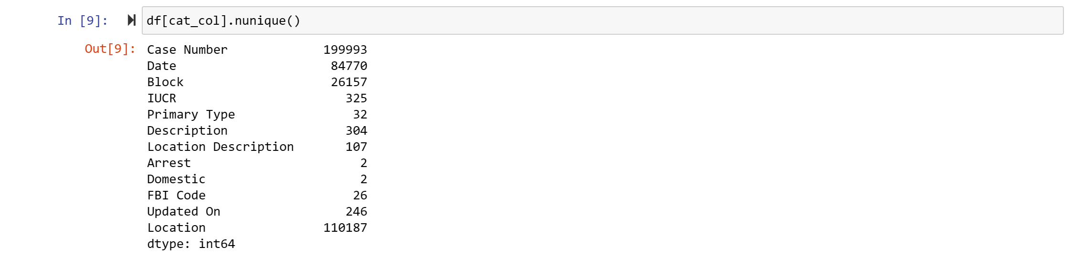
Exploratory Data Analysis
9. Displaying number of unique values in each categorical columns

Slide 19
04
Data Cleaning

Slide 20
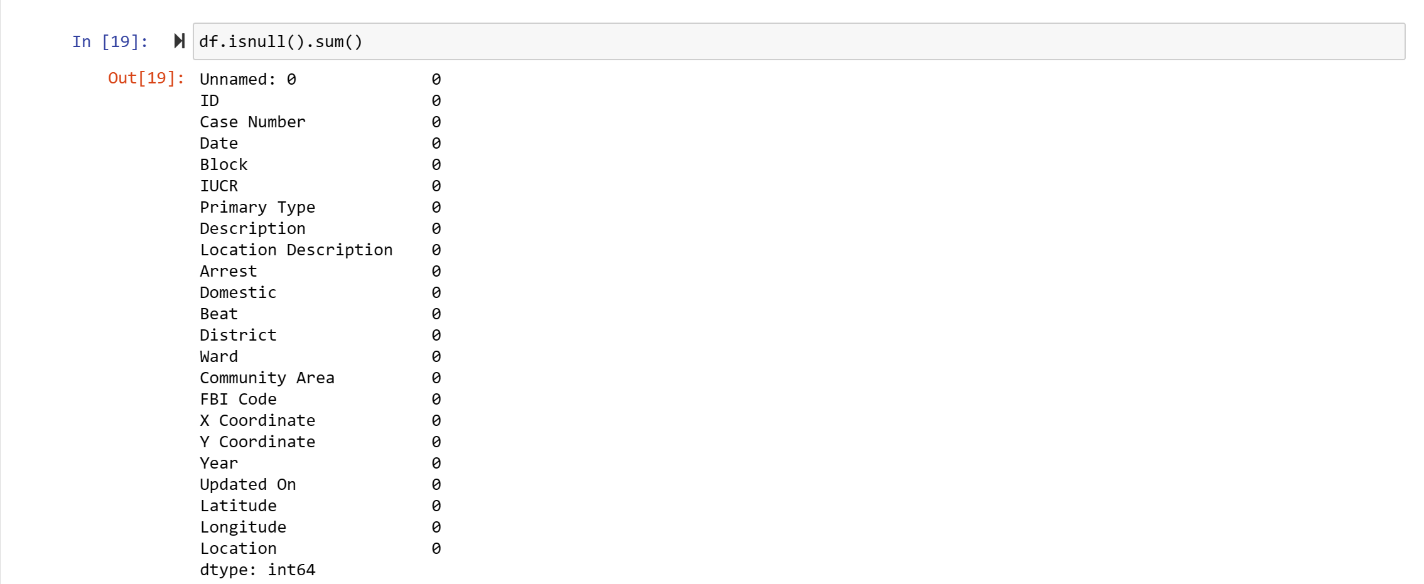
Data cleaning
1. Calculate the total number of missing values in each column

Slide 21
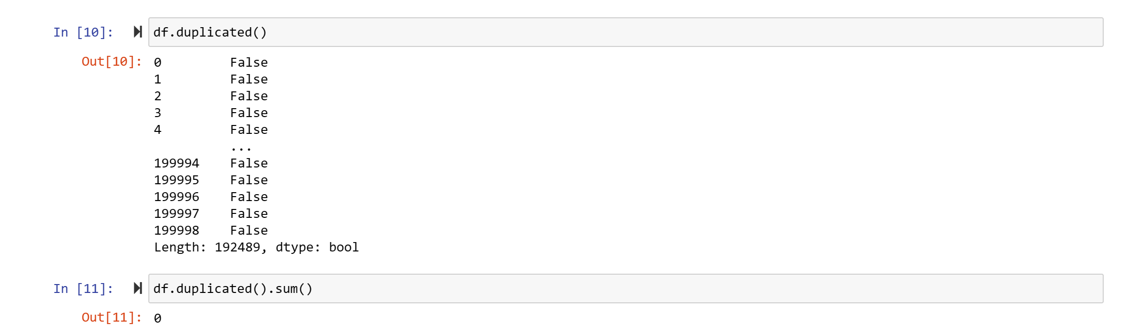
Data cleaning
2. Identify duplicate rows in a dataframe

Slide 22
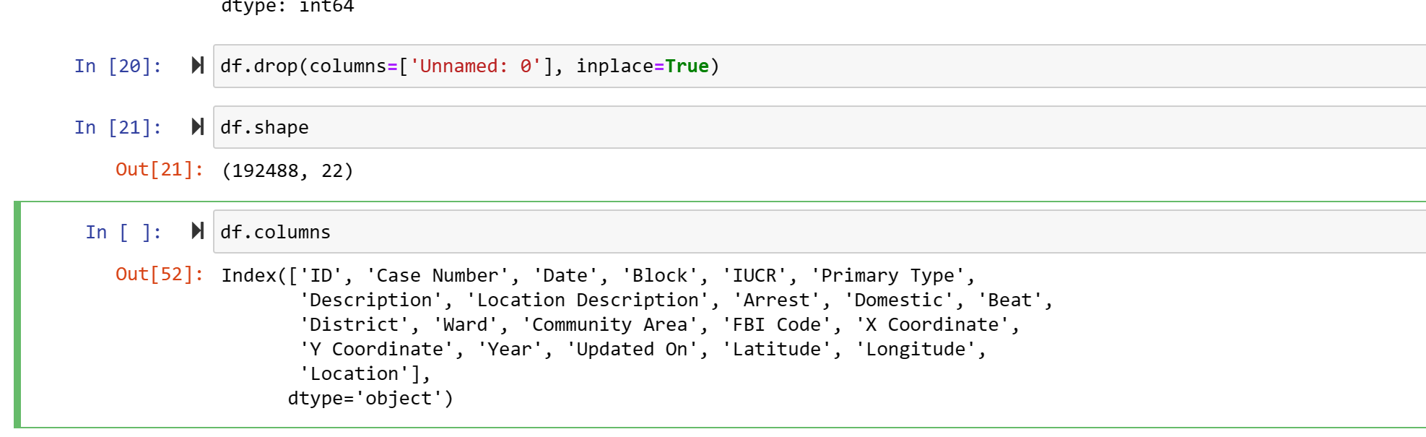
Data cleaning
3. Removing unwanted columns

Slide 23
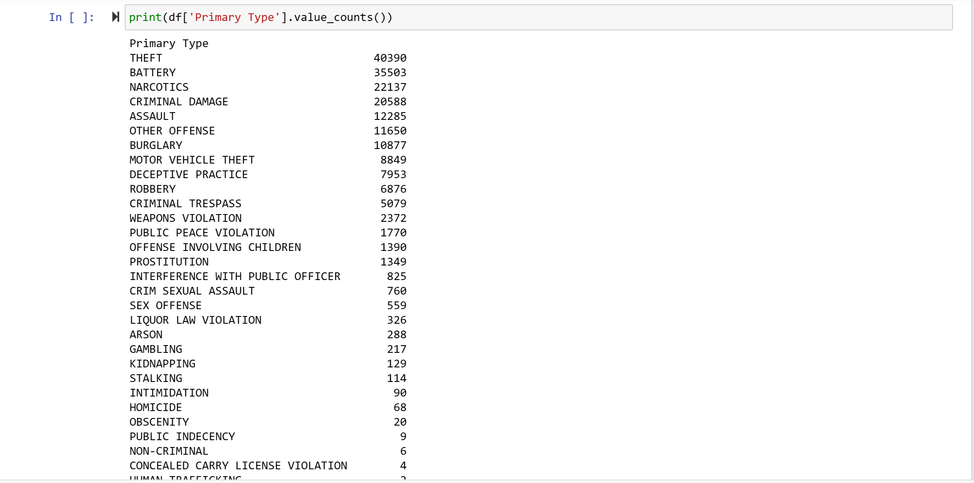
Analysis of Categorical columns
1. Count of each unique value in the ‘Primary Type’ column of the DataFrame, showing the frequency of Different types of crimes

Slide 24
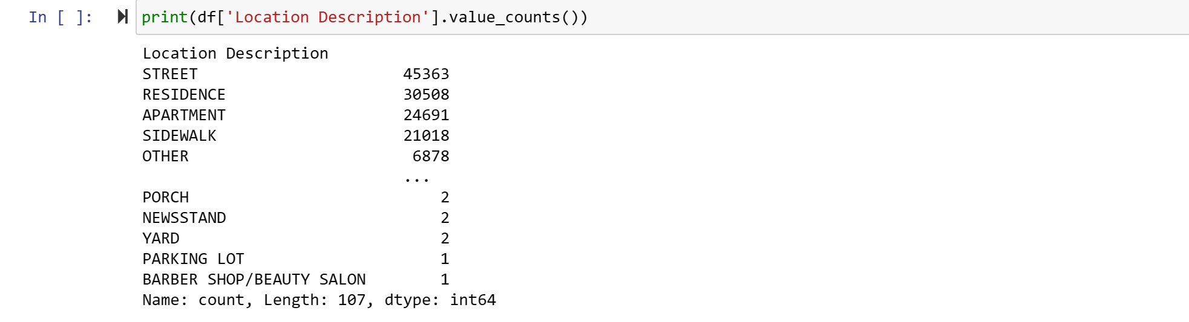
Analysis of Categorical columns
1. Count of each unique value in the ‘Location’ column of the DataFrame, showing the frequency of Different types of locations where the crimes occurred

Slide 25
05
Group By And Cross Tabulation

Slide 26
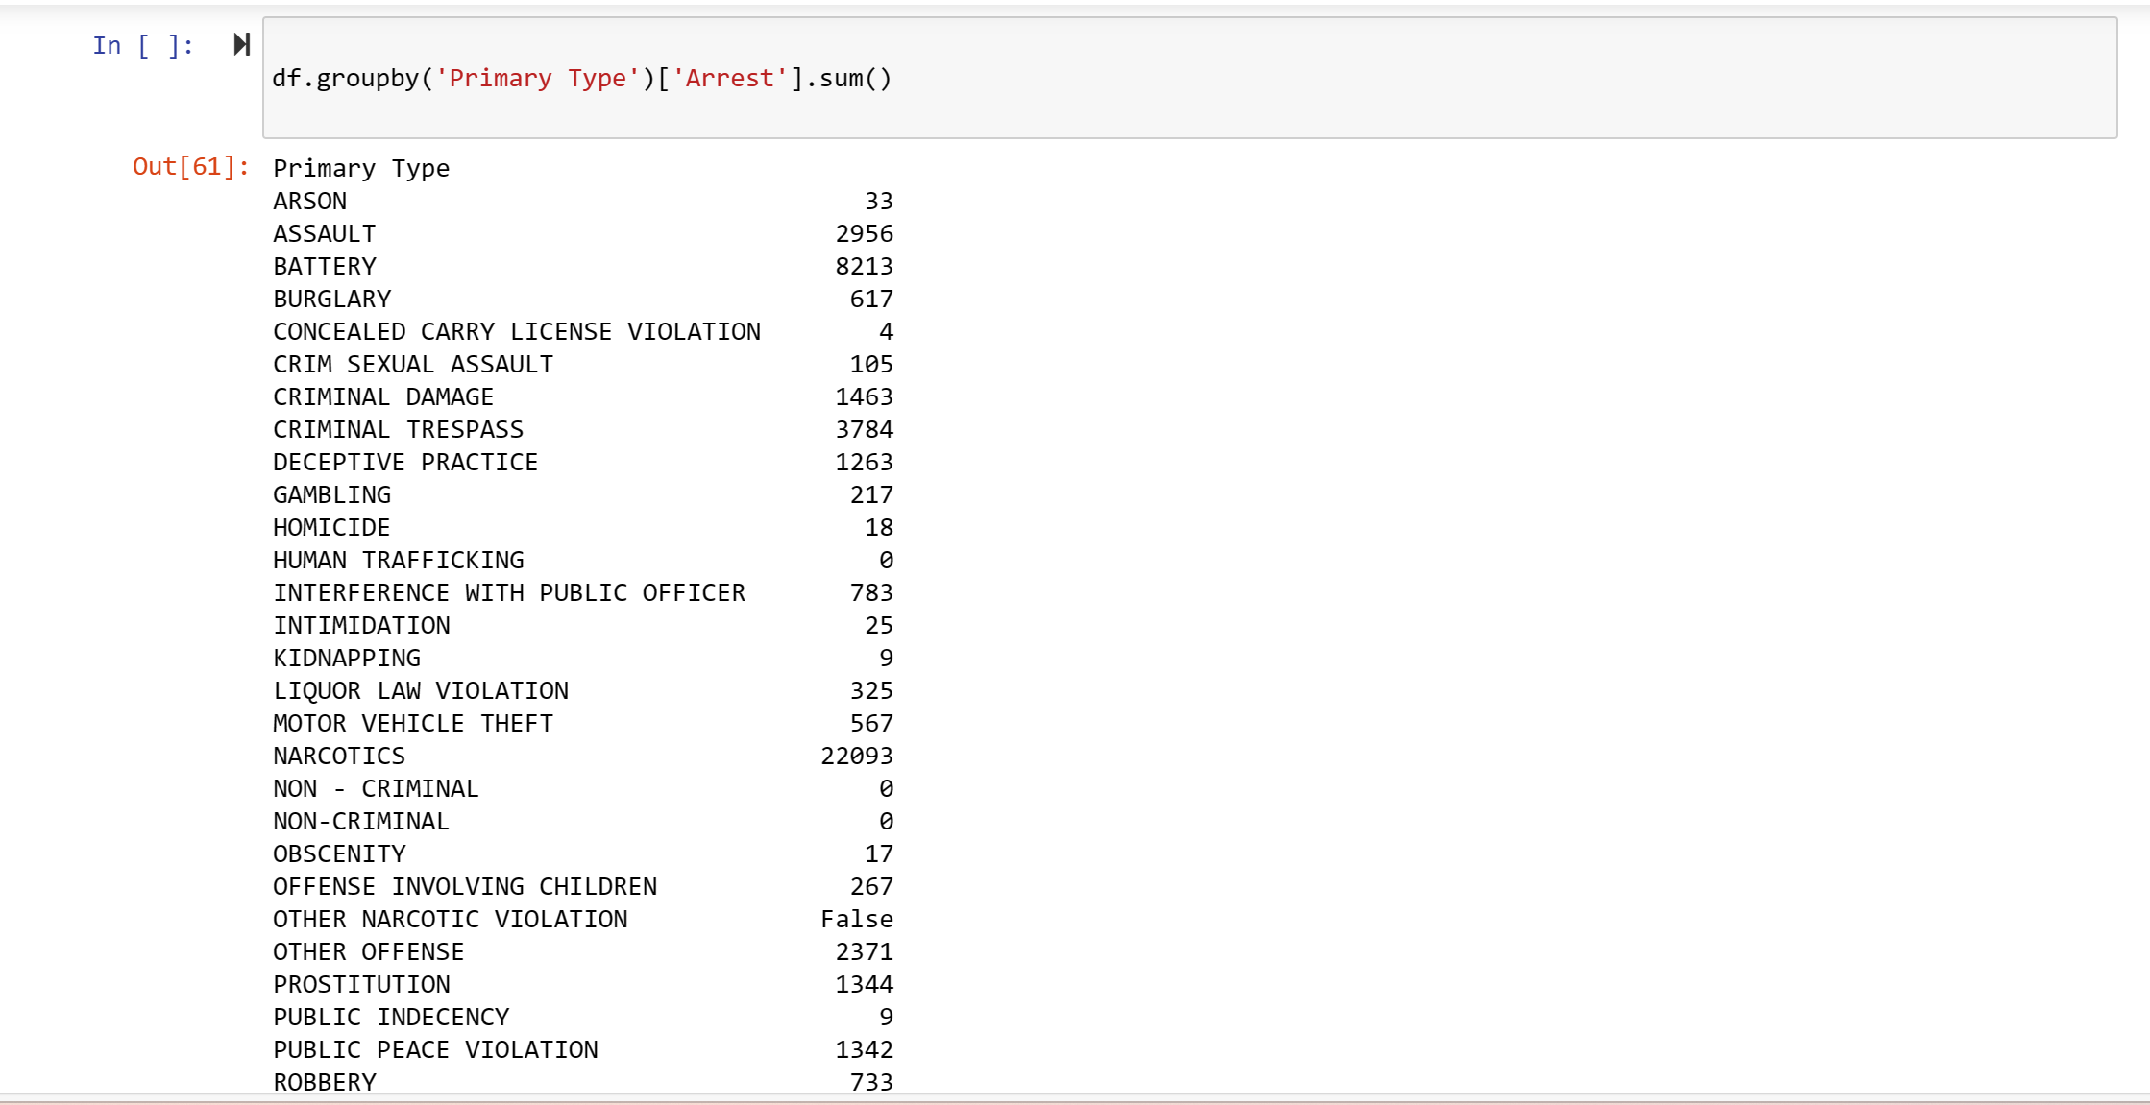
GroupBy
1. Displaying total number of arrets made for each type of crime

Slide 27
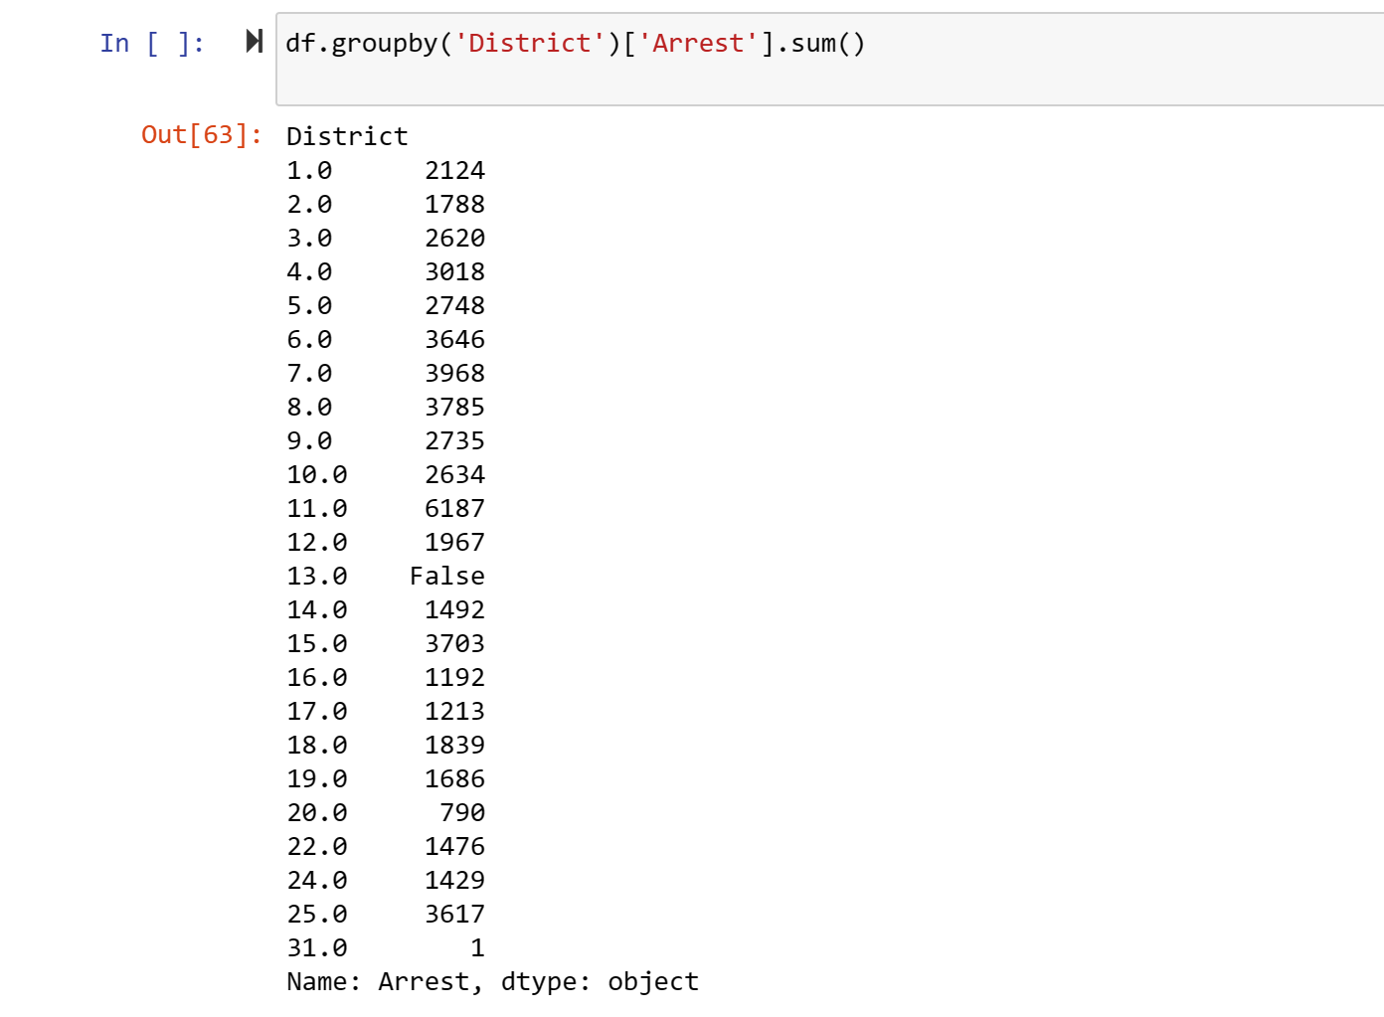
GroupBy
2. Displaying total number of arrets made in each police district

Slide 28
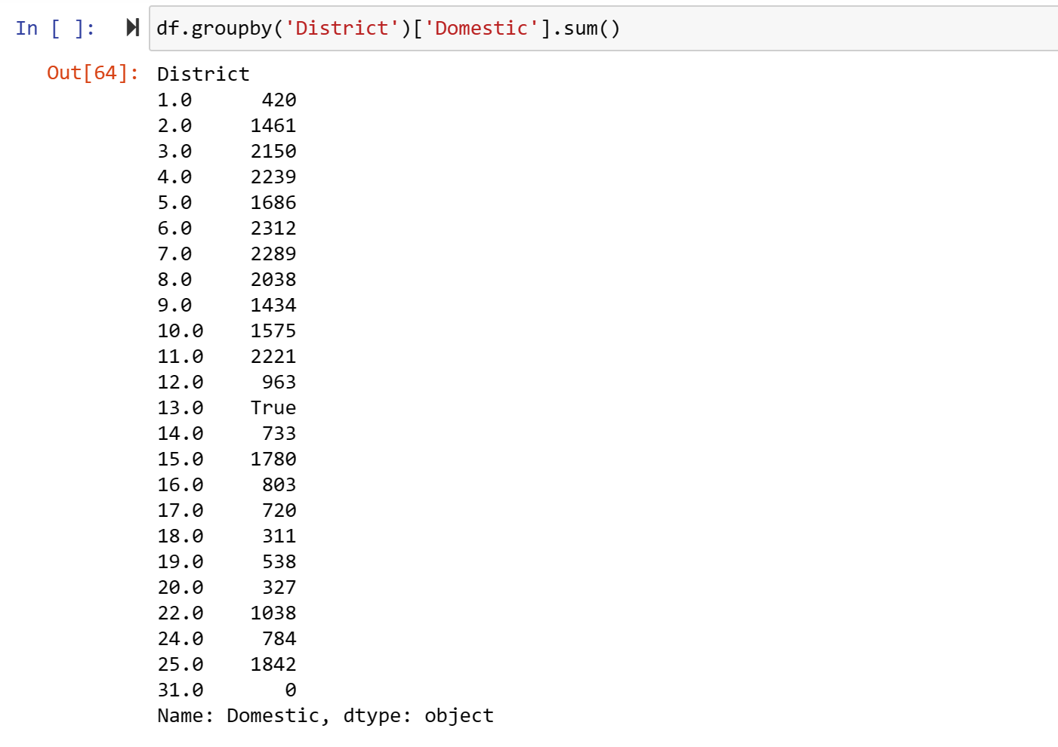
GroupBy
3. Displaying total number of domestic related incident in each police district

Slide 29
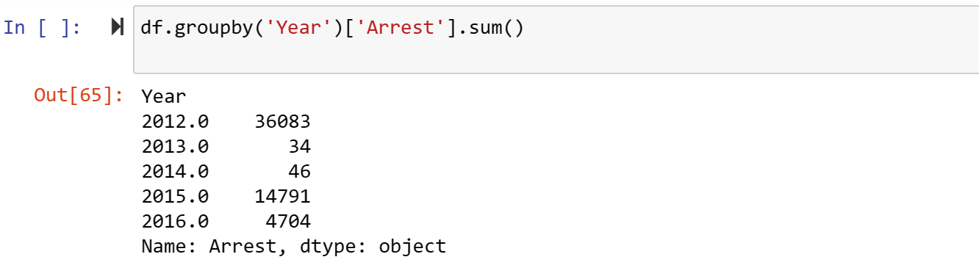
GroupBy
4. Displaying total number of arrest made in each year

Slide 30
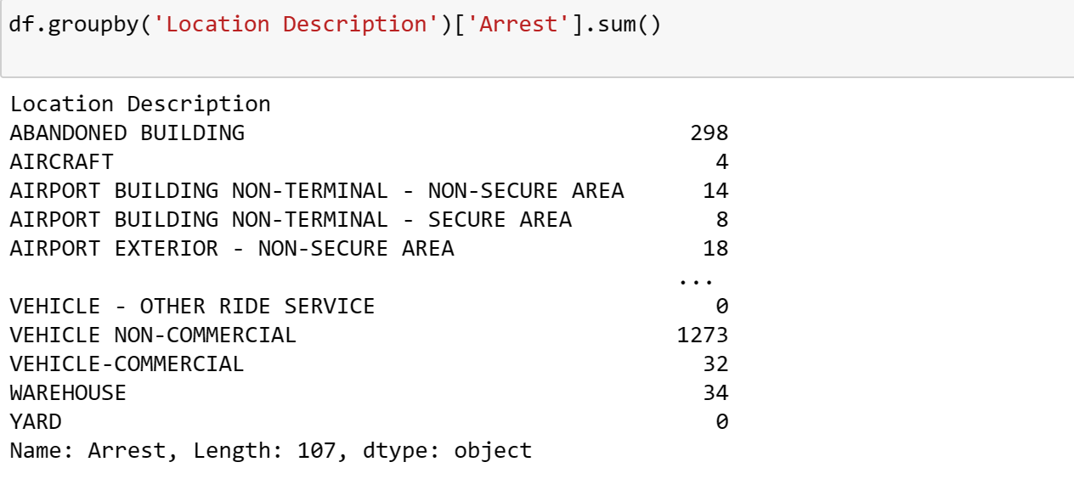
GroupBy
5. Displaying total no of arrest made at each type of location

Slide 31
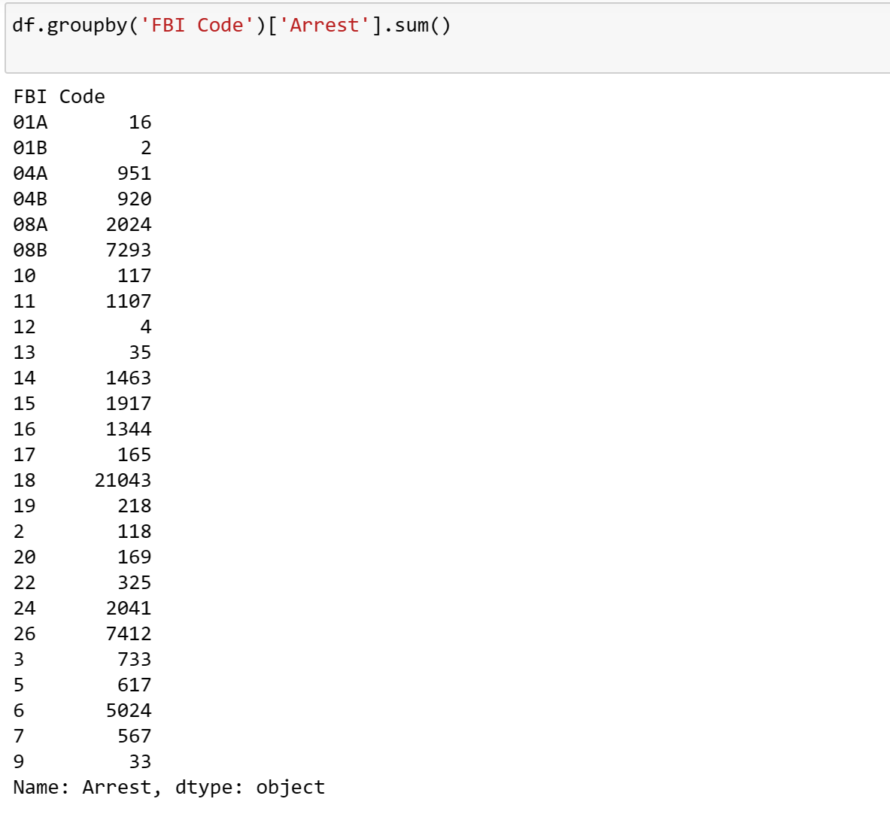
GroupBy
6. Total no of arrest for each FBI crime code

Slide 32
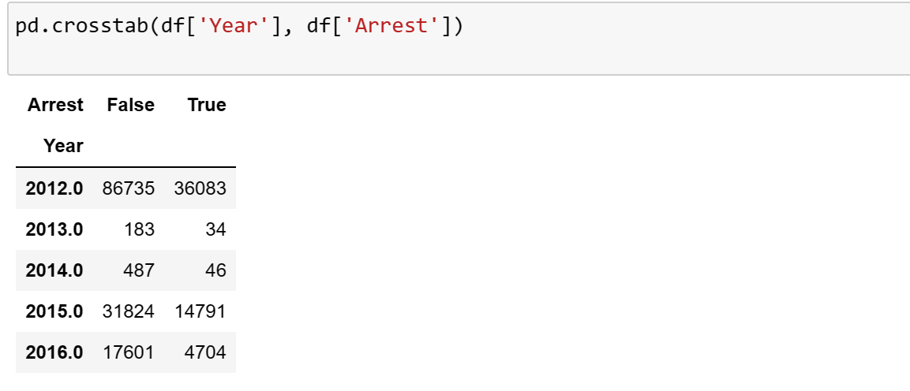
Crosstab
1. Displaying the frequency of arrest and non-arrest for each year

Slide 33
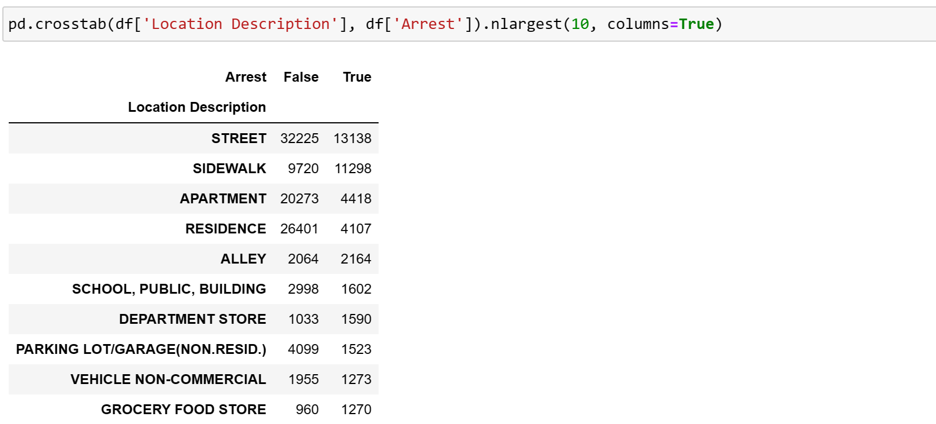
Crosstab
2. Displaying the count of Arrest and non-arrest for each type Location and then select the 10 rows with the largest counts of arrest.

Slide 34
06
Visualization

Slide 35
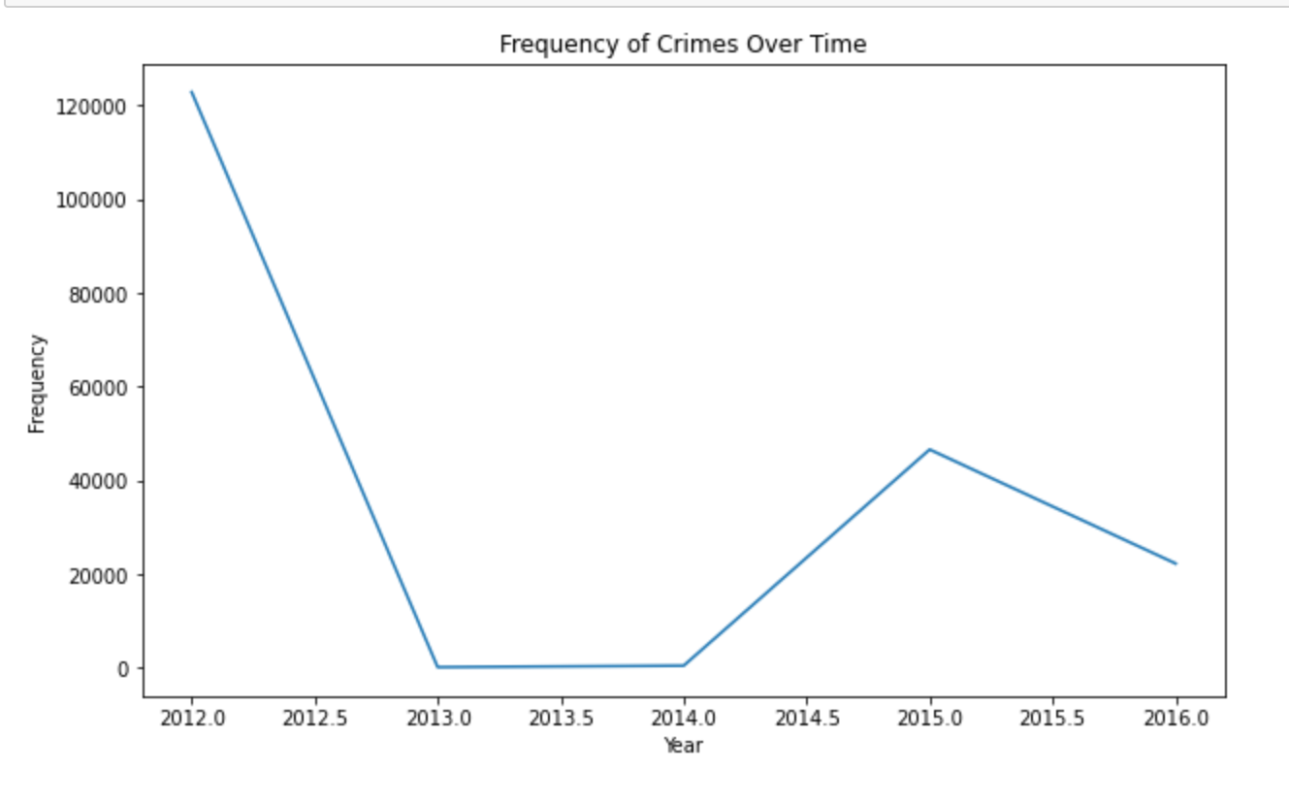
Visualization
1. Frequency of Crimes Over Times:
The graph shows that crime was highest in 2012, but it dropped significantly in 2013 and 2014, reaching its lowest point during that time.

Slide 36
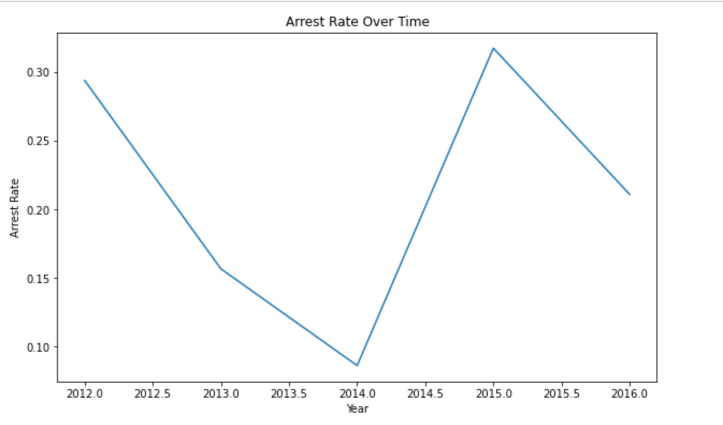
Visualization
2. Arrest Rate Over Time
From this graph, we can see that the number of arrests was highest in the year 2015. On the other hand, the year 2014 had the fewest arrests compared to the other years shown in the graph.

Slide 37
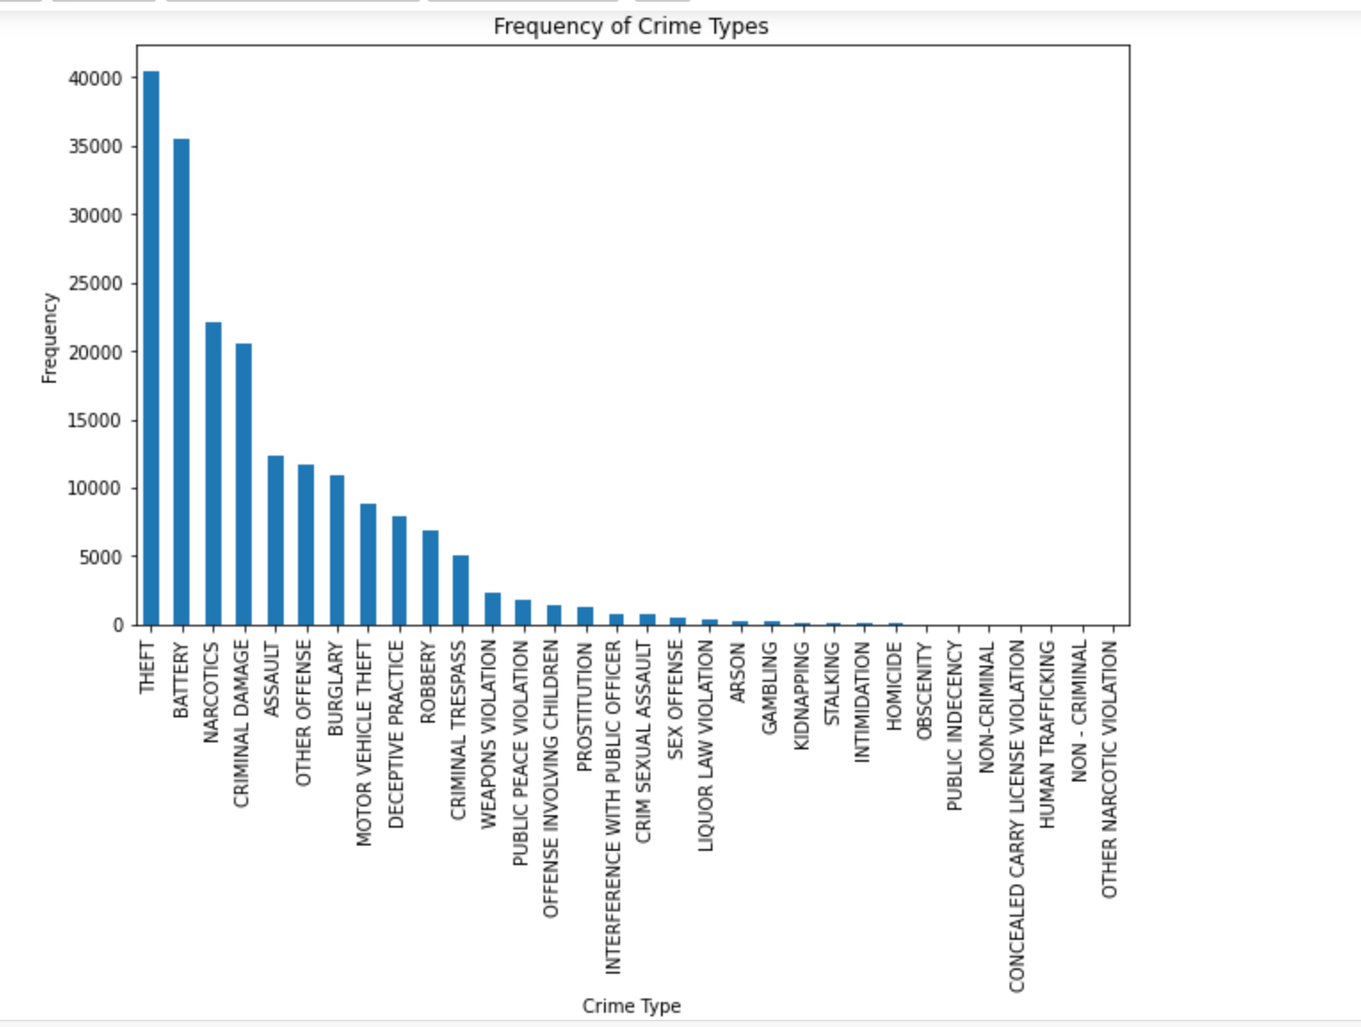
Visualization
3. Frequency of Crime types
This graph tells us that theft was the most common type of crime that occurred.

Slide 38
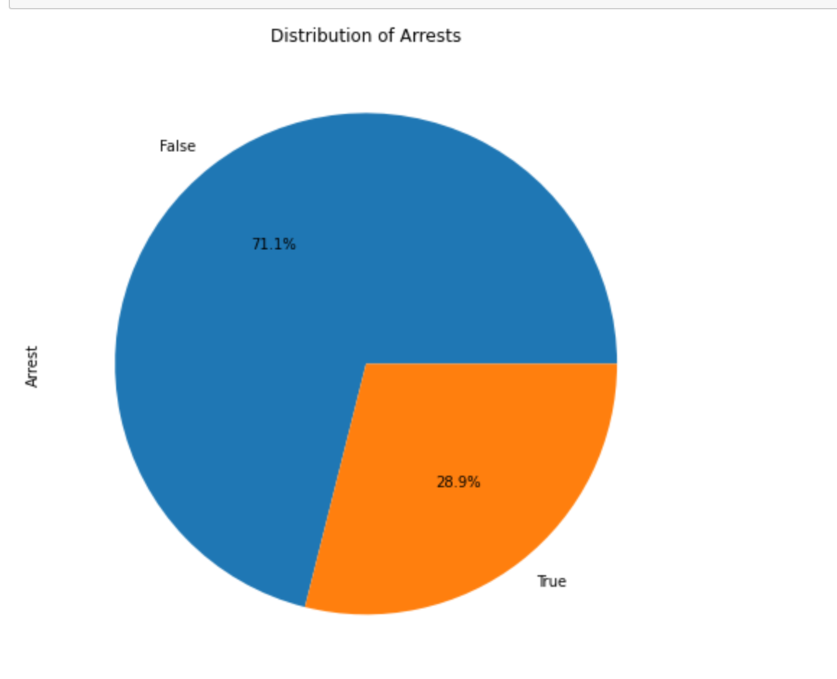
Visualization
4. Distribution of Arrests
Looking at the pie chart, we can see that around 28.9% of the cases resulted in arrest, while the remaining 71.1% did not lead to arrest.

Slide 39
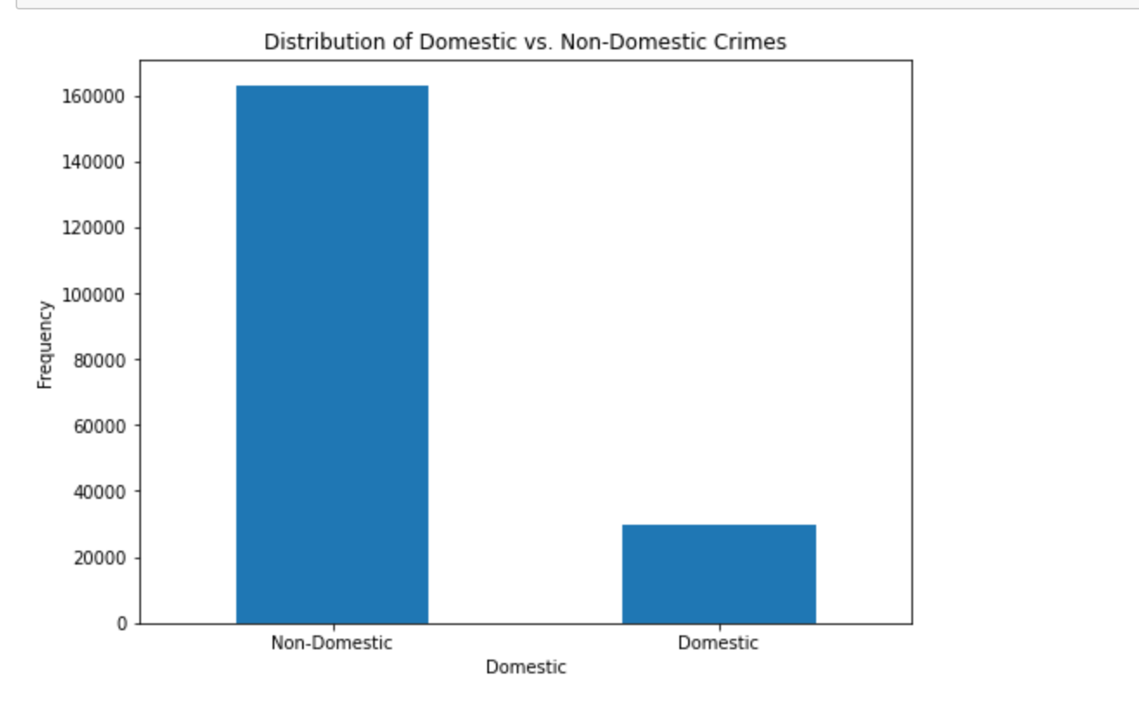
Visualization
5. Distribution of Domestic vs Non-Domestic Crimes
This graph clearly shows that there are more non-domestic crimes compared to domestic ones.

Slide 40
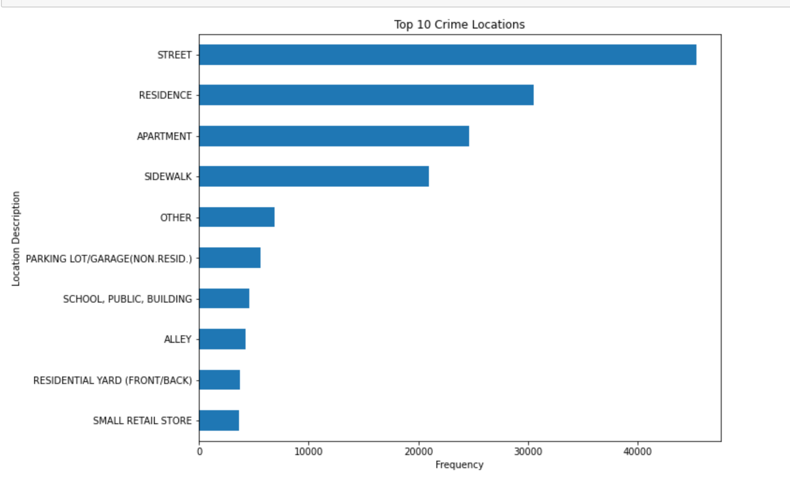
Visualization
6. Top 10 Crime Locations
From this graph, it's evident that the most common location for incidents is on the street.

Slide 41
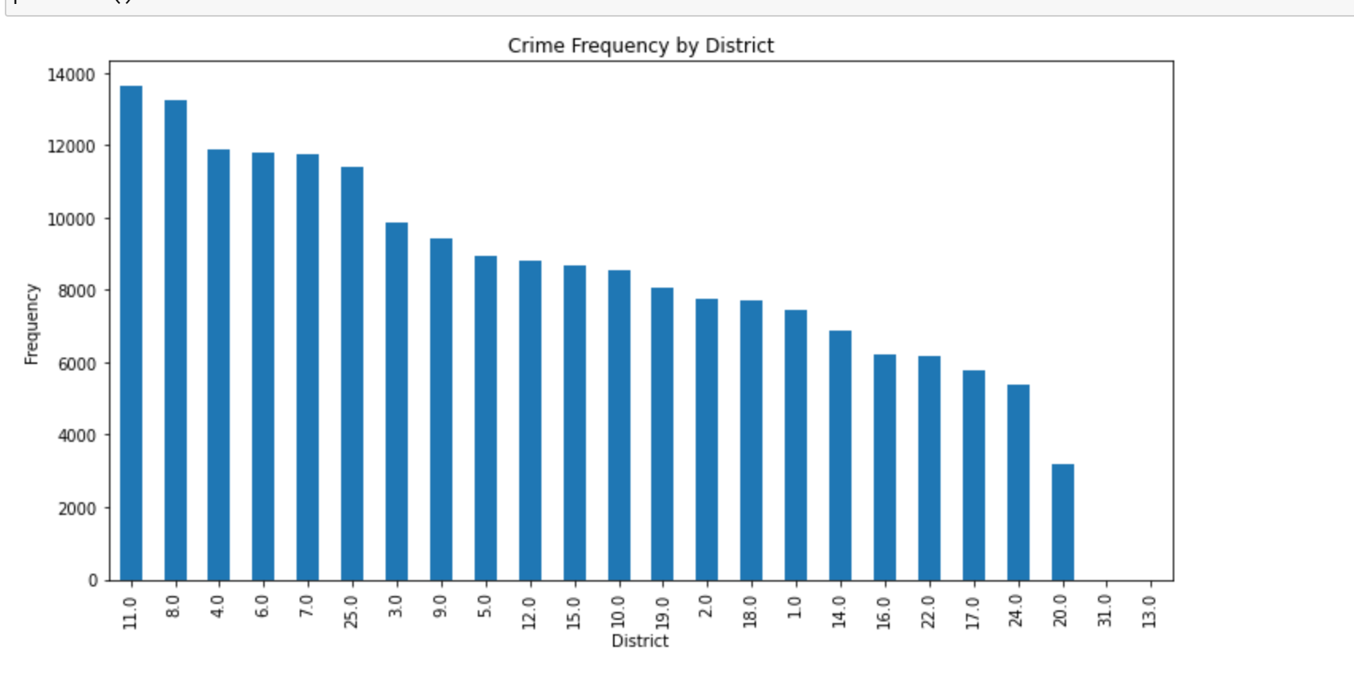
Visualization
7. Crime Frequency by District
This graph indicates that District 11 experienced the highest occurrence of crimes compared to other districts.

Slide 42
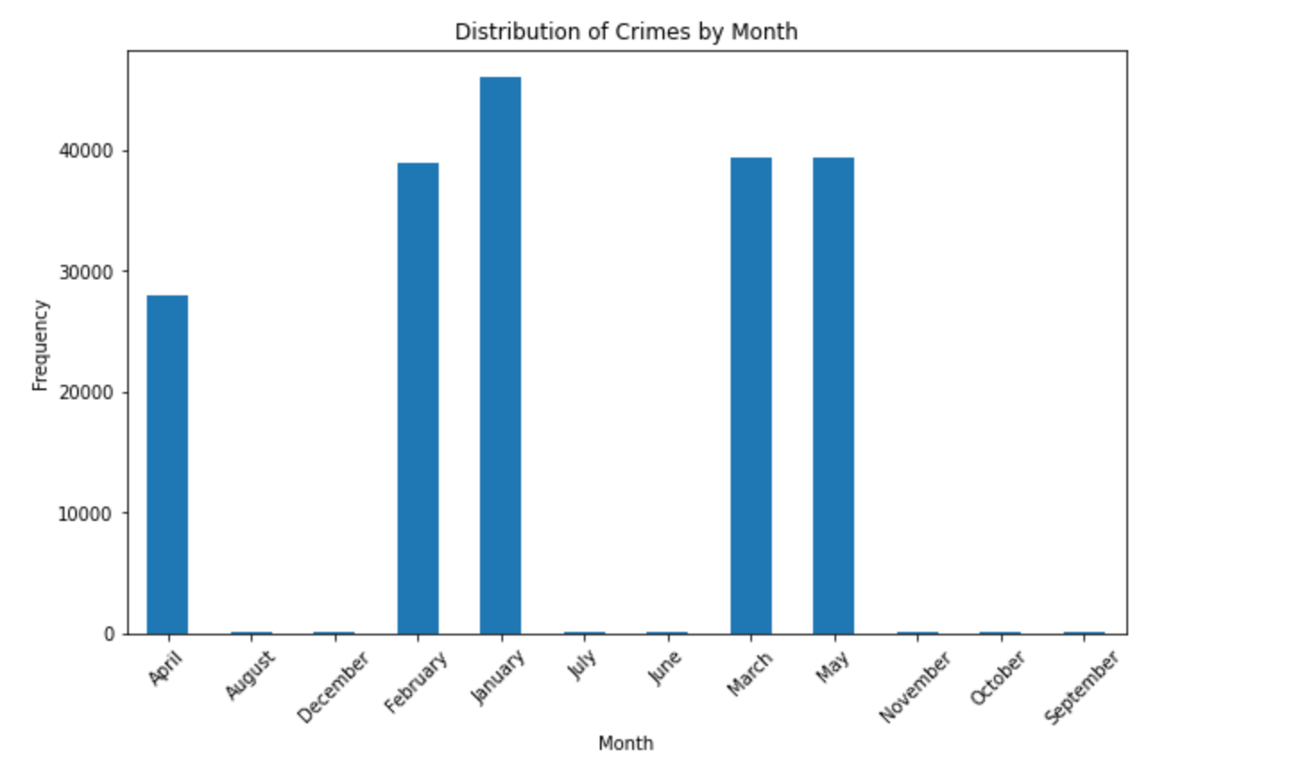
Visualization
8. Distribution of Crimes by Month
This graph indicates that January had the highest number of reported crimes compared to other months.

Slide 43
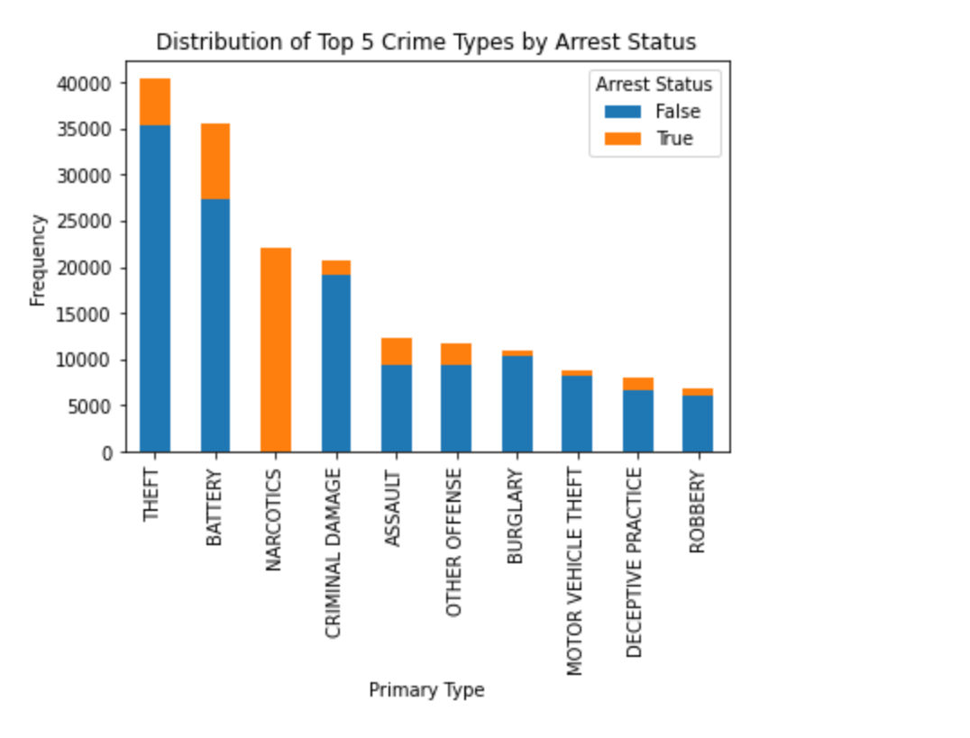
Visualization
9. Distribution of Top 5 Crime Types by Arrest Status
From this graph, we can analyse that for the crime type "Narcotics," all individuals involved were arrested.

Slide 44
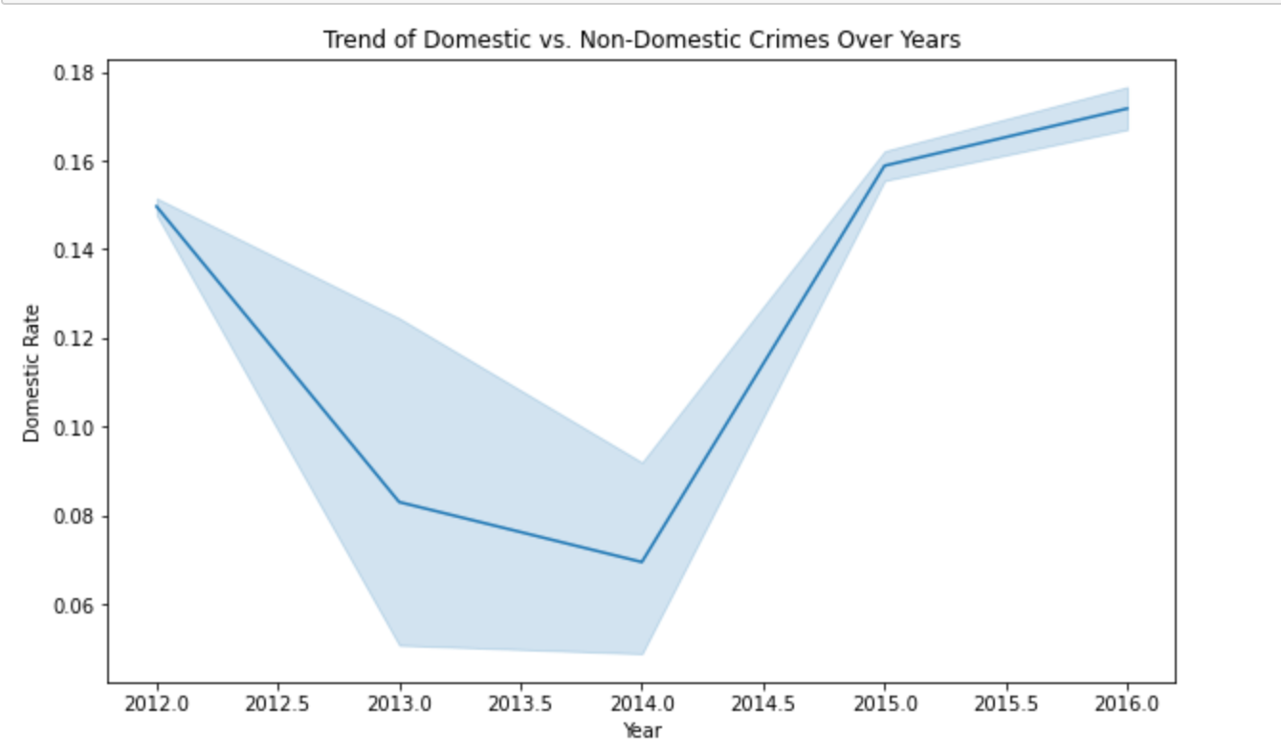
Visualization
10. Trend of Domestic vs. Non-Domestic Crimes over
From this graph, we can analyze that the incidence of domestic crime peaked in the year 2016.

Slide 45
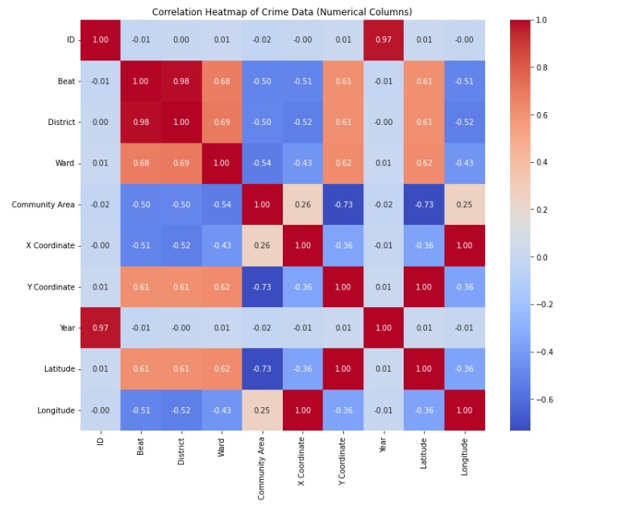
Visualization
12. Correlation Heatmap of crime Data Numerical columns
When the correlation coefficient is close to 1, it indicates a strong positive correlation between the two attributes, meaning that as one attribute increases, the other tends to increase as well. Conversely, when the correlation coefficient is close to -1, it signifies a strong negative correlation, indicating that as one attribute increases, the other tends to decrease. A correlation coefficient near 0 suggests little to no linear relationship between the attributes.

Slide 46
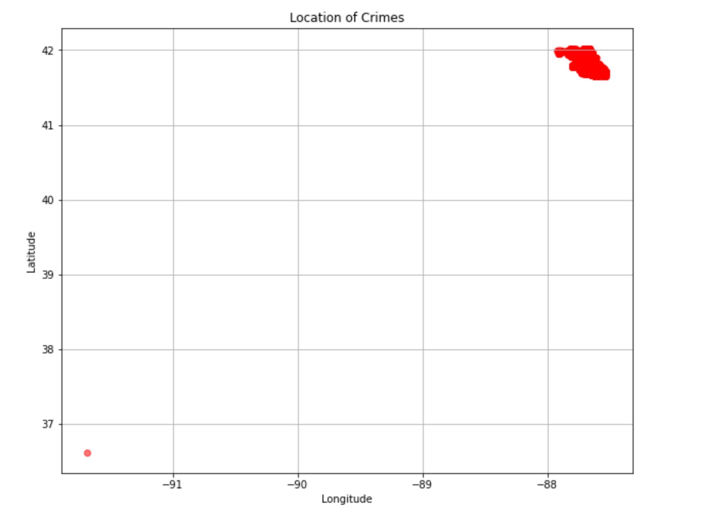
Visualization
13. Location of crimes
The scatter plot displays the locations of crimes based on latitude and longitude. Each point represents a single crime incident. The dark shade color in the top-right corner indicates a higher concentration of crime incidents in that particular area.

Slide 47
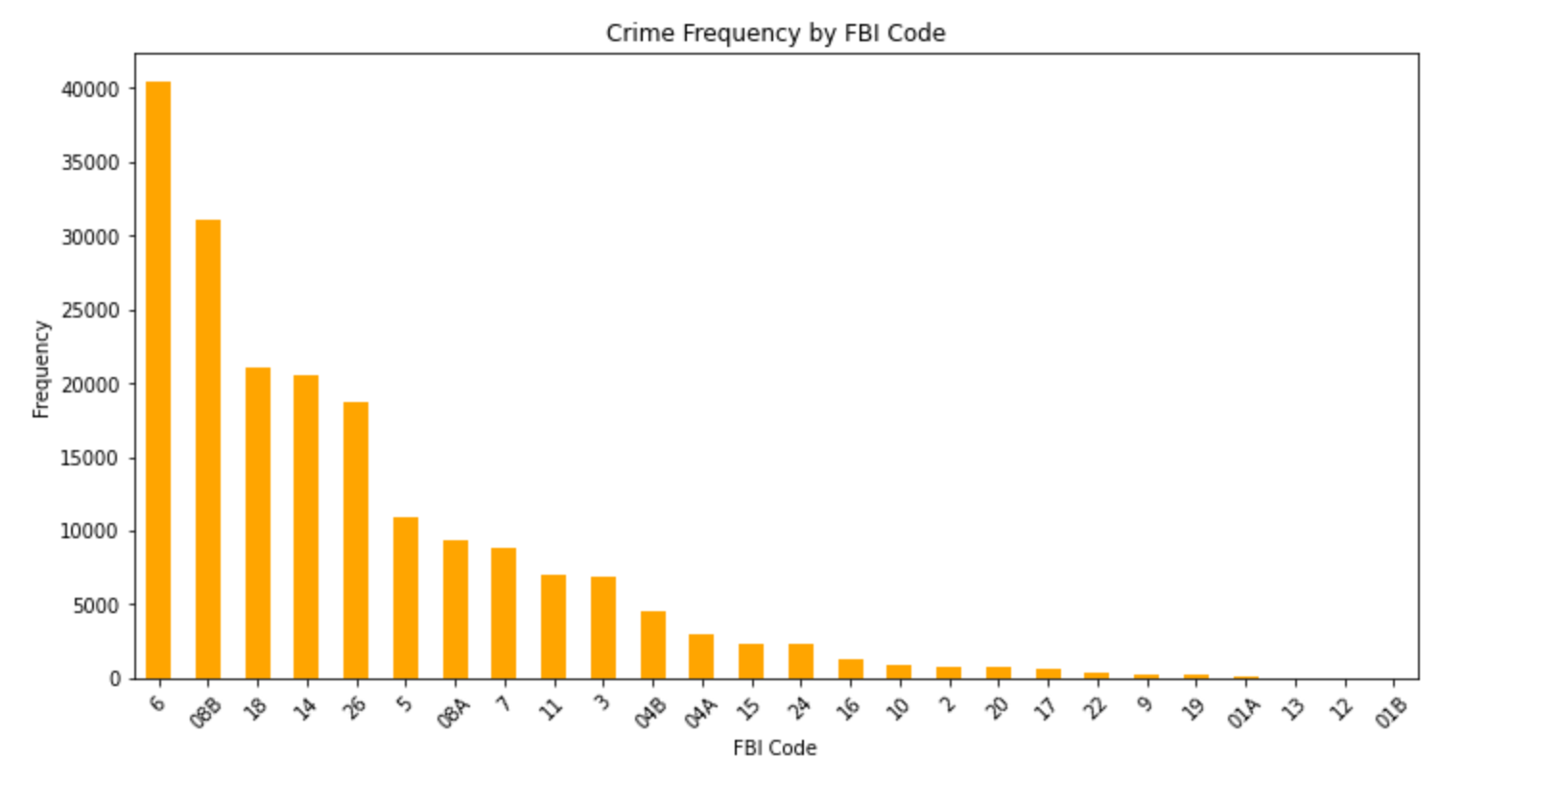
Visualization
14. Crime Frequency by FBI code
From this graph, it indicates that there are more occurrences of crimes classified under the FBI code 6 compared to other FBI codes.

Slide 48
Thank You

